Slide 1
Abstract
So. You’re a developer in an organisation and want your code or pipelines distributed to other teams. You can hand out your git repository URL and wish your colleagues good luck, but you can also provide them with a little bit more. I helped create a tool to synchronise Azure DevOps code from one repository to another, including registering the pipelines. This way, my colleagues can start using the pipelines from my products right away. Another use case is the security department. When a security vulnerability needs a script to generate an inventory of vulnerable systems or a tool to patch the vulnerability, the SecOps team can distribute the necessary files to all the teams with a push of a button. Join me in this talk, learn how you can utilize the Azure DevOps API to handle the nitty-gritty git stuff, and empower your end users with your tools.

Slide 2
Next Up:
Jelle de Graaf

Slide 3
3
3

Slide 4
2

Slide 5
1

Slide 6
Deploy your code and pipelines to your internal customers
Jelle de Graaf

Slide 7

Many thanks to our sponsors:

Slide 8





Jelle de Graaf
OGD ict-diensten
DevOps engineer
Automation, PowerShell, gaming
/jelledegraaf
Notes:
OGD ict-diensten, an IT service provider in The Netherlands
Current activities: DevOps engineer, automating everything
Things I like: Automation, PowerShell, gaming on any possible platform (even PowerShell)
Today I want to tell you an origin story about something that my team wrote. We have to go back in time about five years. When Corona was just a beer brand, the UK was still in the European Union, and I looked a bit different.

Slide 9

Notes:
Transitional slide only

Slide 10

Notes:
I worked in an internal devops team, automating anything and everything for our internal colleagues…

Slide 11


Notes:
…We had an application. This application consists of several PS scripts, run by Azure Pipelines. The application had to be distributed to 50+ ADO projects, to be used by all the customer teams.
Deploying the application required some manual steps, though.

Slide 12


Challenge 1
To deploy the application:
Manually import repository
Manually register pipelines
Manually share service connection
Manually set pipeline permissions
Solution:
Sync files and register pipelines by script
Notes:
Import the source repository into your own ADO project
Register any pipelines present
Create a shared service connection
Give pipeline permissions to use service connection, variable group, agent pool and template pipelines.

Slide 13
Challenge 2
To update the application:
Manual git operations required
Solution:
Schedule script and opt-in for automatic updates

Slide 14
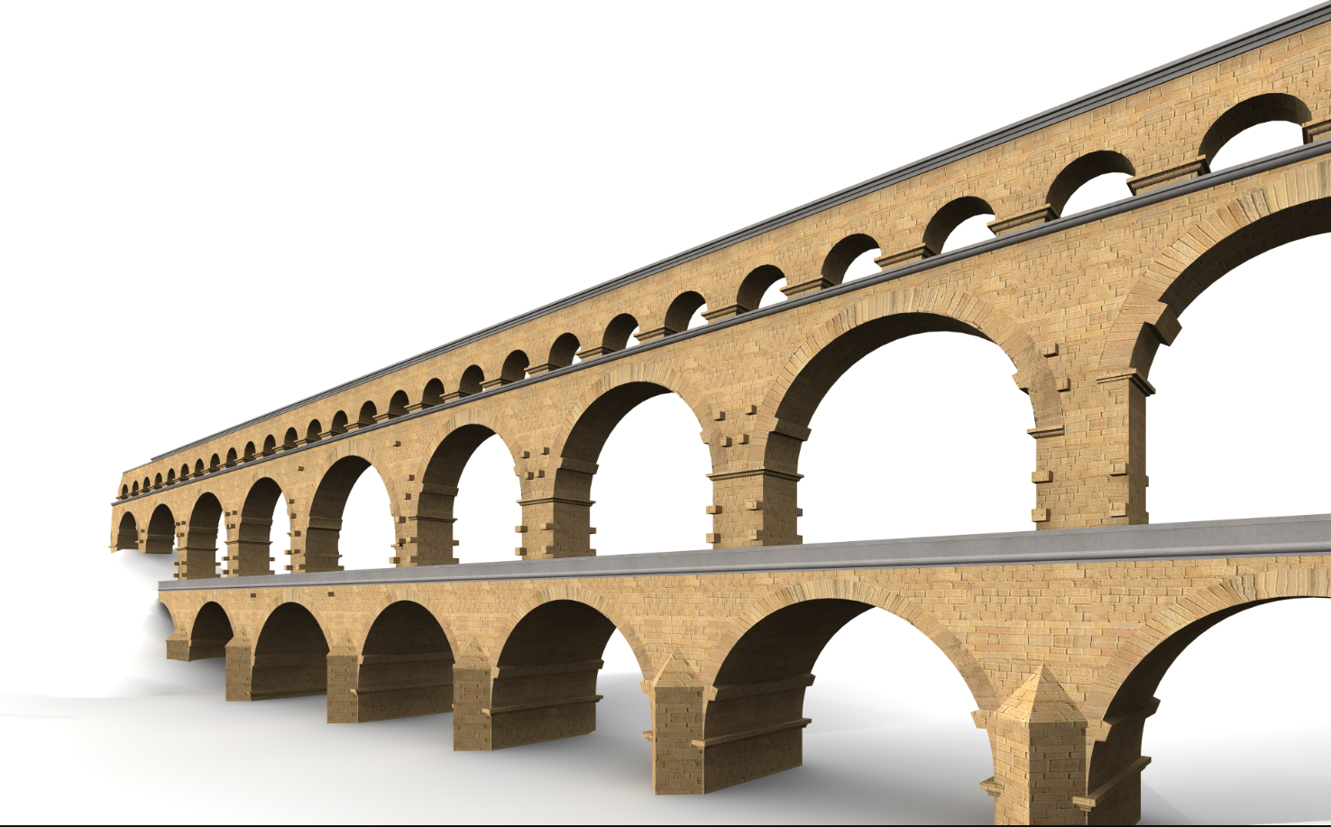
Meet Aquaduct
Synchronize files on Azure DevOps
Specifically for pipelines
Anywhere to anywhere inside organization

Slide 15

Problem
Anywhere to anywhere is a big security risk
Solution:
Restrict sources (AquaductAllowed.txt)
Restrict destinations (Aquaduct.json)
Notes:
If you can copy files from anywhere, you are able get content you might not have permissions on. This can be anything from confidential customer data to top-secret projects from colleagues.
Possibly even worse: if you can place your content on any project, you effectively have a remote execution scenario, because you can automatically register a scheduled pipeline to execute a script.

Slide 16

Problem
Copied scheduled pipelines are active immediately
Solution:
Opt-in for registration
Notes:
Active pipelines might come as a surprise to administrators. For example: one pipeline requires some configuration to work correctly. If that starts before the configuration has been done, it generates errors.

Slide 17

Notes:
One day, security team came knocking on our door.

Slide 18
Extra request
Push responses to target audience
Feature: reinstate push functionality
Only for security department
Only with branch policies
Notes:
This circumvents the security measure that you can only specify your local repository as a destination in Aquaduct.json. It opens up the breach we patched before, but there are a few extra countermeasures:
This is only for one group of people (the security department)
This works by placing the content in a specific folder. That folder is protected by branch policies, so at least two people are required to start a push.

Slide 19

Why is Aquaduct cool?
Saves manual work
Scales very well
Multiple use cases emerge
Notes:
It saves all the beforementioned manual steps for deploying and updating the tool
Scales very well, as long as you keep increasing your App Service plan (our 50+ deployment runs on Standard S2, for $146,- per month)
Use cases:
Deploy complete application
Deploy central pipelines
Deploy maintenance toolbox
Enable security to push

Slide 20
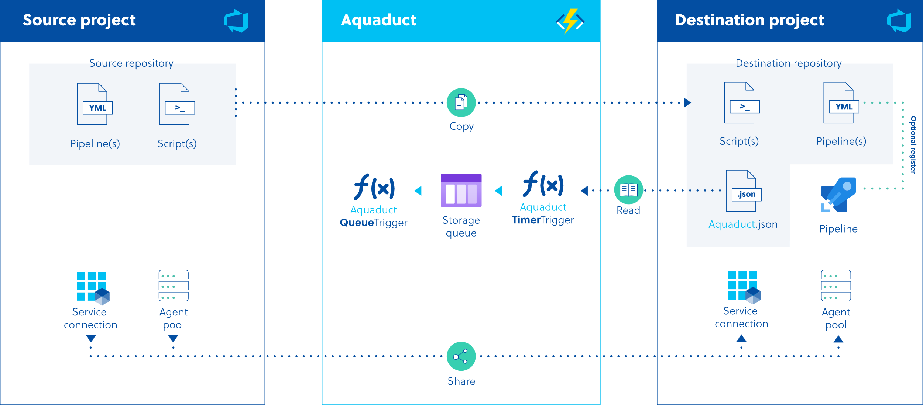

Slide 21
Notes:
Source repository
The source repository requires the following:
Something to synchronize (obviously)
A file called AquaductAllowed.txt. This is a text file which’ presence is checked when copying data. Its content is only for end users: saying what it is for and to not remove it.

Slide 23
Notes:
Destination repository
Aquaduct only adds to the destination repositories, it never deletes. This was by request of the end users, who would like more control on what gets removed from their repositories. Deletions have to be done manually, or by deleting the entire sync tree and synchronizing again.
The destination repository contains the file for end user configuration: Aquaduct.json.

Slide 24
Notes:
End user configuration
Aquaduct.json is used by end users to configure their synchronization(s). It contains the following items, among others:
Source location (project, repository, folder)
(optional, for security department only) destination location (project, repository, folder)
Switch for automatically registering the pipelines

Slide 26
Notes:
Azure function: timer trigger
Scheduled periodically (every 30 minutes), can be edited to suit needs.
Creates the actual sync jobs for the queuetrigger function (fan out principle)

Slide 27
Notes:
Azure function: queue trigger
Triggers on item in storage queue, placed by timer trigger.
Processes jobs, based on settings derived from Aquaduct.json.
Parallel (timerTrigger generates up to 56 jobs).

Slide 29
Notes:
Pipelines (destination project)
Pipelines get registered (when desired)
Pipelines with schedules are live immediately (careful)

Slide 31

Notes:
Timer trigger script
Search for Aquaduct.json in entire organization
Read configuration file for settings
Process each sync relation
Check validity for sync
Create messages in a storage queue

Slide 32
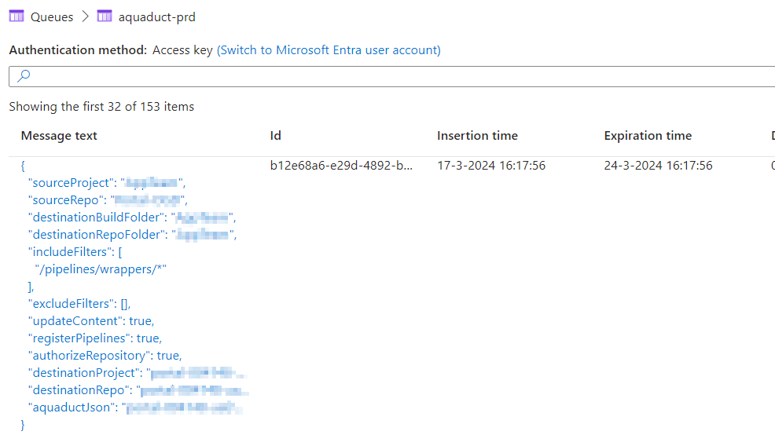
Notes:
Storage queue: job content
This is what the jobs in the storage queue look like. Basically just some data in JSON format.

Slide 33
Notes:
Queue trigger script
Take inventory of all source files
Check for existing copies
Apply filters
Register pipelines
Approve to use source repository. Comes in handy when you work with wrapper pipelines
Register shared service connection
Register and authorize shared agent pool
Uses API endpoints: /git, /pipelines, /build

Slide 35
Demos
We love Demos!
Notes:
That’s how it works in theory. Allow me to show you how it all comes together in practice.
Show source repository (files)
Show almost empty destination repository (files and pipelines)
Start timerTrigger function
During the wait show insides of Aquaduct.json, what to expect
Show log of queueTrigger function after it has finished
Show result (files and pipelines) in destination repo/project
Demonstrate proper working (run new pipeline)

Slide 36

Pitfalls
Lock service account away
Keep security standards high
Registered pipelines are active
Notes:
If you use one service account to sync all the data, make sure that access to that account is restricted.
Make sure people can’t get data from or put data on locations that aren’t explicitly allowed.
Understand that registered pipelines with a schedule or trigger, are active immediately.

Slide 37
Recap
Synchronize files
Register pipelines
Register required components
Runs on Azure Function App
Security must be maintained
Flexible end-user configuration
Result: Easy software deployment

Slide 38

Notes:
This works like a charm for us. Maybe it will for you as well?

Slide 39

T.Hanks!

Slide 40
Q&A
15 minutes

